Slide 1
DETECTION OF FAKE ONLINE TRANSACTIONS USING FEATURE REDUCTION AND MARGIN MAXIMISATION
STUDENT NAME: B.SRI HARSHA
PIN NO :2503A52L04
BRANCH :CSE-AI&ML
PROJECT NAME :DETECTION OF FAKE ONLINE TRANSACTION.
UNDER THE GUIDENCE OF SOUTRICK DAD..

Slide 2
PROBLEM STATEMENT:
Online Transaction Fraud
Unauthorised transactions using stolen credentials
Why Detection Matters
Billions lost annually to fraudulent activities
Key Challenges
Massive datasets, extreme class imbalance, evolving fraud patterns

Slide 3
PROJECT OVERVIEW
Input Data
Transaction features extracted
ML Model
PCA + SVM processing
Output Result
Fraud or genuine classification
Real-time detection capability for immediate fraud prevention

Slide 4
DATASET DESCRIPTION
Feature Composition
Time: transaction timestamp
Amount: transaction value
V1–V28: PCA-transformed features
Class: fraud indicator (0/1)
PCA Anonymisation
Original features transformed via Principal Component Analysis for privacy

Slide 5
FEATURE REDUCTION: PCA
Dimensionality Reduction
Transforms 30+ features into optimal components
Noise Removal
Eliminates redundant and correlated variables
Computational Efficiency
Reduces training time and model complexity

Slide 6
SUPPORT VECTOR MACHINE (SVM)
Maximum Margin Hyperplane
Creates optimal decision boundary maximising separation between classes
Why SVM for Fraud?
Effective with high-dimensional data
Robust to outliers
Works well with class imbalance
Clear margin provides confidence

Slide 7
SYSTEM ARCHITECTURE
Input Layer
Raw transaction data collection
Preprocessing
Feature scaling and normalisation
Model Inference
PCA transformation + SVM classification
Prediction Output
Fraud probability and classification

Slide 8
MODEL TRAINING PROCESS
Data Cleaning
Missing values, outliers removed
Feature Scaling
Standardisation for SVM optimisation
Train-Test Split
80/20 split with stratification
Model Training
SVM fit with cross-validation

Slide 9
PERFORMANCE METRICS
Accuracy
Overall correctness of predictions
Precision
Proportion of flagged fraud that is actual fraud
Recall
Proportion of actual fraud successfully detected
F1 Score
Harmonic mean balancing precision and recall

Slide 10
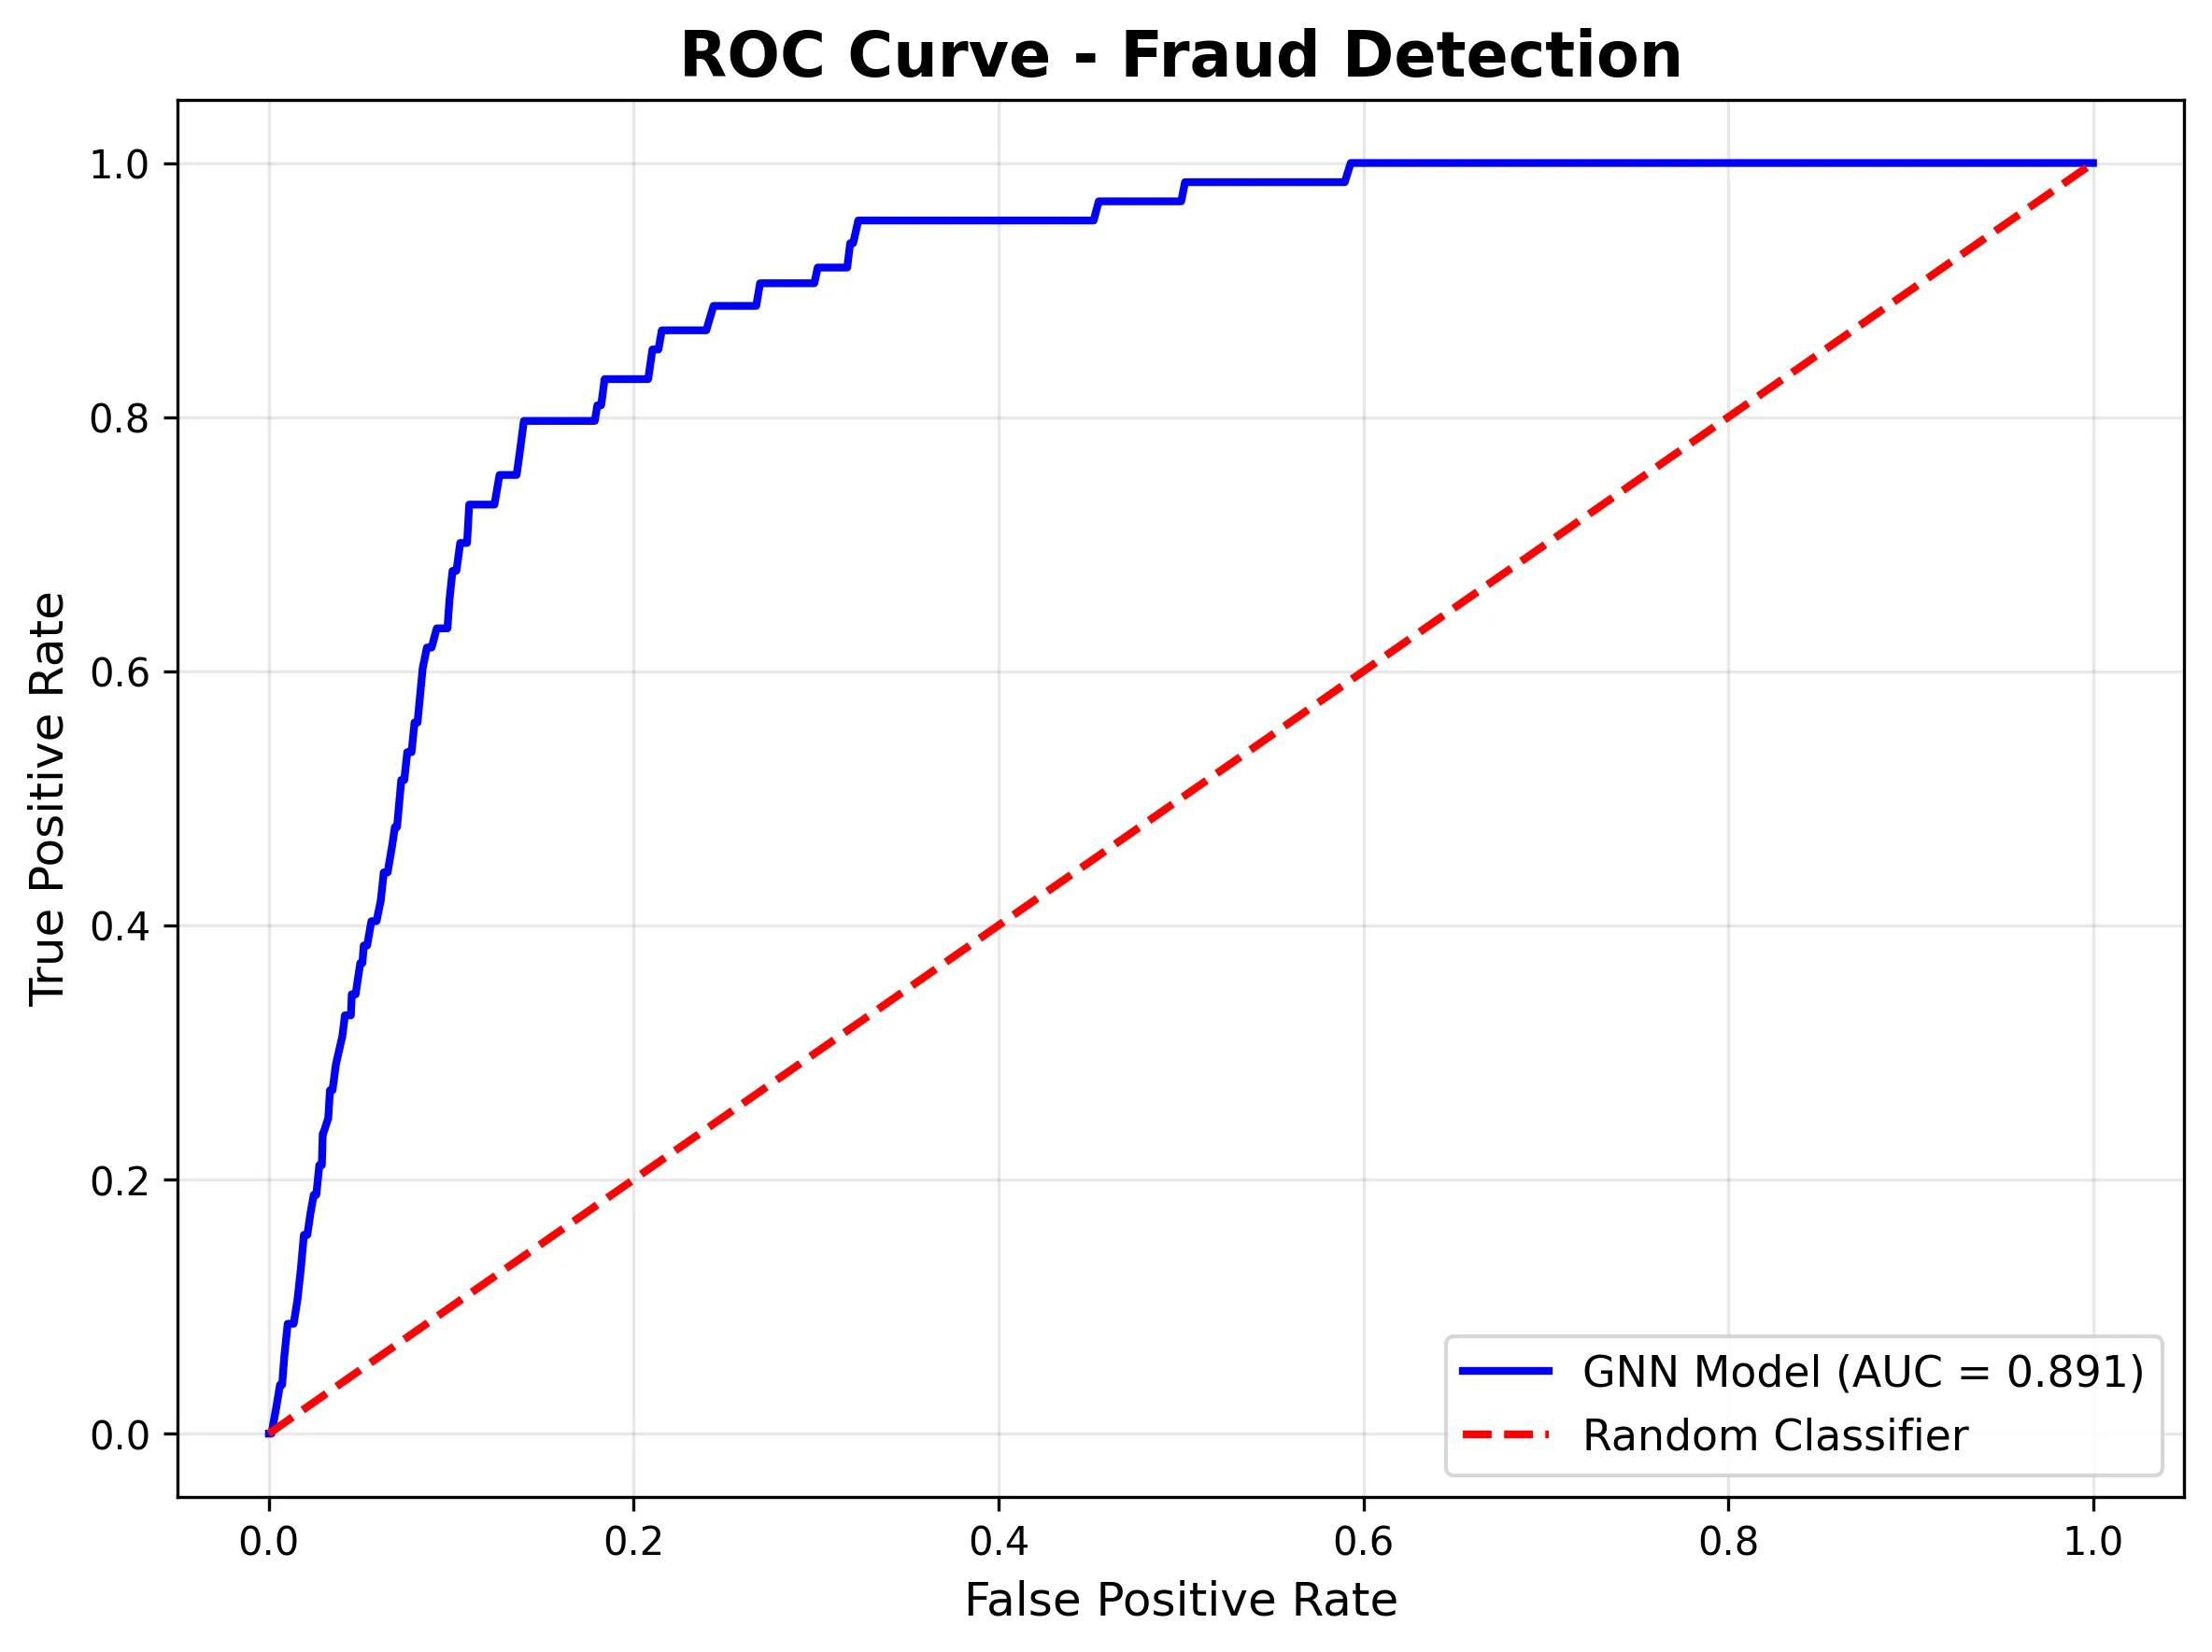
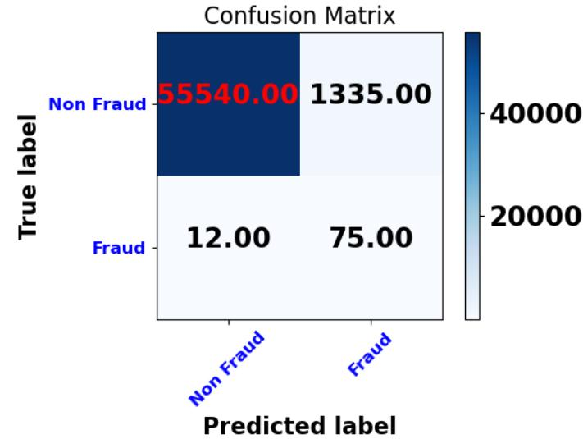
l
l
l
l
l
l
l
l
l
OUTPUT DIAGRAMS

Slide 11
RESULTS & CONCLUSION
Visual Results
Confusion matrix showing true/false positives
ROC curve with AUC score
Precision-recall curves
Feature importance analysis
Key Advantages
Fast detection, accurate predictions, handles large datasets efficiently

Slide 12
CONCLUSION: PCA-based dimensionality reduction combined with SVM margin maximisation effectively identifies fraudulent transactions with strong precision-recall balance, demonstrating practical viability for real-time banking applications..

